Slide 1
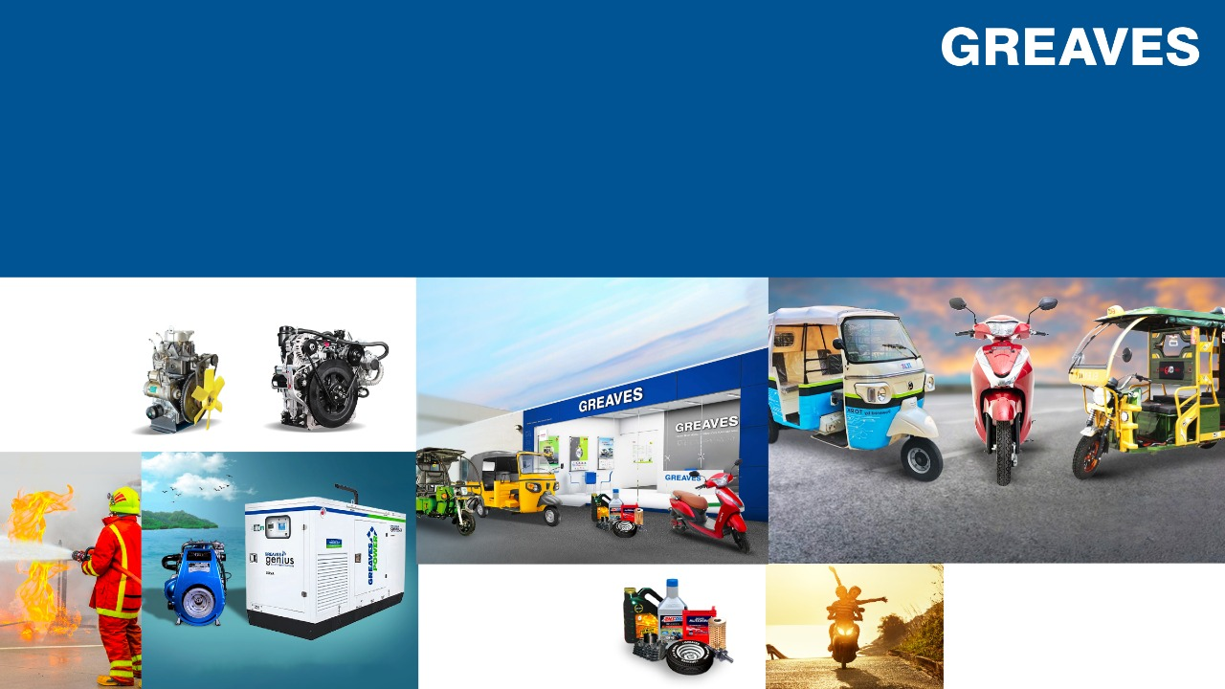
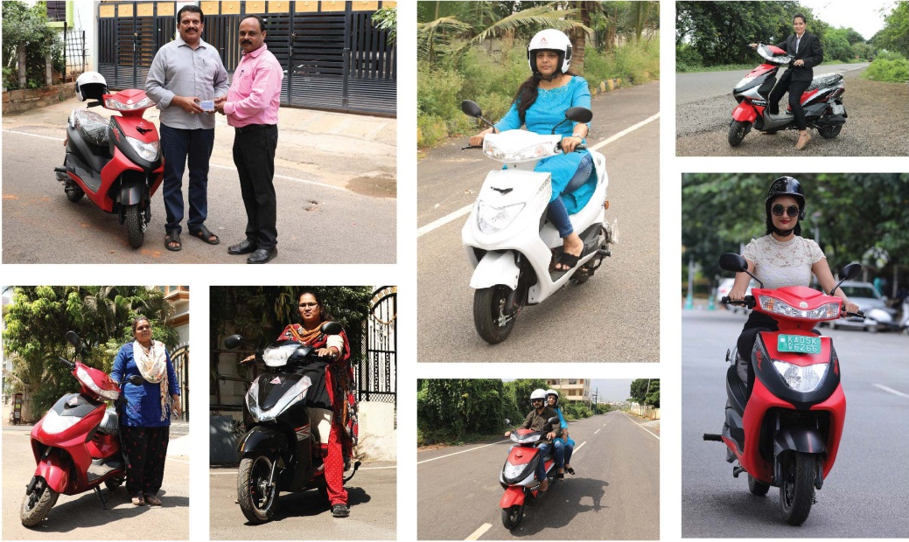
PEOPLE.
PHYGITAL.
PROGRESS.
Q2 and H1 FY2023 Earnings Presentation
(14th November 2022)
POWERTRAIN
RETAIL
ELECTRIC MOBILITY
FINANCE

Slide 2
Q2 FY23 highlights
Greaves Electric Mobility recorded highest ever quarterly sales of 33K units
Revenue
Rs. 699 Cr
+87% y-o-y
+6% q-o-q
EBITDA
Rs. 43Cr
Margin: 6.1%
PAT
Rs. 32 Cr
Margin: 4.6%
Greaves Electric Mobility (GEM) recorded highest ever quarterly revenue of INR 318 crores and EBITDA of INR 8 crores
GEM accounts for 46% of overall revenue
Ampere continues to be a fast-growing e-Mobility brand
  Y-o-Y growth of 256%; QoQ growth of 13%
Auto Applications business registered YoY growth of 109%;
Non-Auto Applications registered YoY growth of 17%
Greaves Retail registered a growth of 46% in H1 FY23
Recorded strong QoQ growth across all business segments
GEM Revenue
Rs. 318 Cr
+256% y-o-y
+13% q-o-q
Cash Position
INR 1,268 Cr.
as on 30th September’ 2022

Slide 3

Management commentary
Last mile mobility segment is recovering, and reaching pre-covid levels, with increasing penetration of EVs
E-mobility business recorded highest ever sales of 33K units; H1 FY23 volume was higher than full year of FY22
Overall powertrain business is growing with improved margins
GEMPL focusing on building a robust new product roadmap for electric 2 & 3 wheelers with indigenous technology & supply chain
In 2 wheelers, we are designing & developing products across consumer categories & price segments
Accelerating EV adoption with nearly 700 outlets across distribution chain and launch of E2W on e-com platform
With the diversification strategy, H1 FY23 group revenue was 135% of the pre covid levels
Nagesh Basavanhalli
Executive Vice Chairman
We are happy to announce the growth across different business units, resulting in highest ever quarterly revenues, and consistent improvement in profitability. Our focus on accelerating adoption of electric vehicles and transforming last mile mobility with clean transport solutions, have strengthened our leadership position in this fast growing market. Led by a strong & passionate leadership team, our group is investing in building competitive advantage in clean technology, product innovation and design.

Slide 4





Corporate structure for accelerated growth
POWERTRAIN
MOBILITY
3-Wheelers
Last Mile Mobility
Other Applications
2-Wheelers
RETAIL & SERVICES
Multi-Brand
retail format
Multi-Brand service format
Note: Financials and volumes as of Q2 FY23

Slide 5
Financial results reflects success of Greaves’ diversification strategy
Consistent growth riding on strong brand traction and improved efficiency
621
660
513
486
330
374
229
Rs. in crores
B2C business contribution increased to 65%
Q2 FY22
Q2 FY23
The diversification strategy has delivered consistent growth amidst significant industry disruption
Investment in e-Mobility to be utilized for new products, associated technologies, brand building and to enhance manufacturing capacity in e2W / e3W
Contribution of B2C business is steadily growing
GCL
GEM

Slide 6
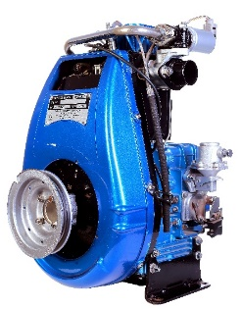
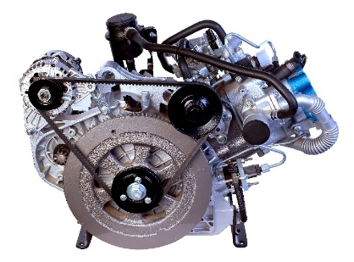

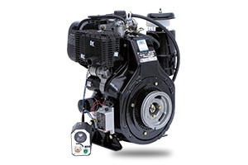
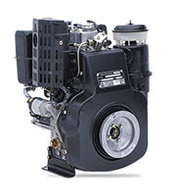
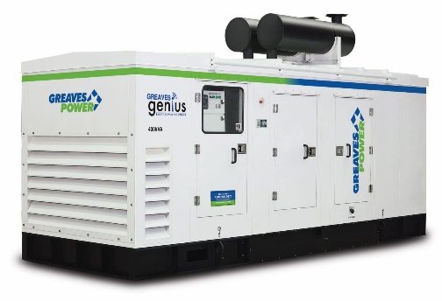
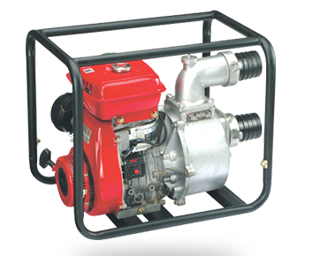
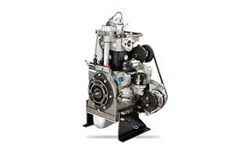

Diversified portfolio of powertrain products
Auto Applications
Non-Auto Applications
R& D powerhouse with proven success in diesel and CNG engines, & now rapidly building expertise in electric powertrain
Working on next emission compliance - OBD2A
Brought back low-cost mechanical diesel BS VI engine, G435 in October 2022
Conformity to stringent safety standards UL, FM, TAC and NFPA 20 norms
Catering to diversified customer segments with applications across Farming, Marine, Construction, Auxiliary Power, Industrial, Defense, Railways and more
Designed for superior performance and long operations
Gearing for CPCB4+ compliance for gensets
Compliant with
Industrial
Solutions
Power Solutions
Agri
Solutions

Slide 7








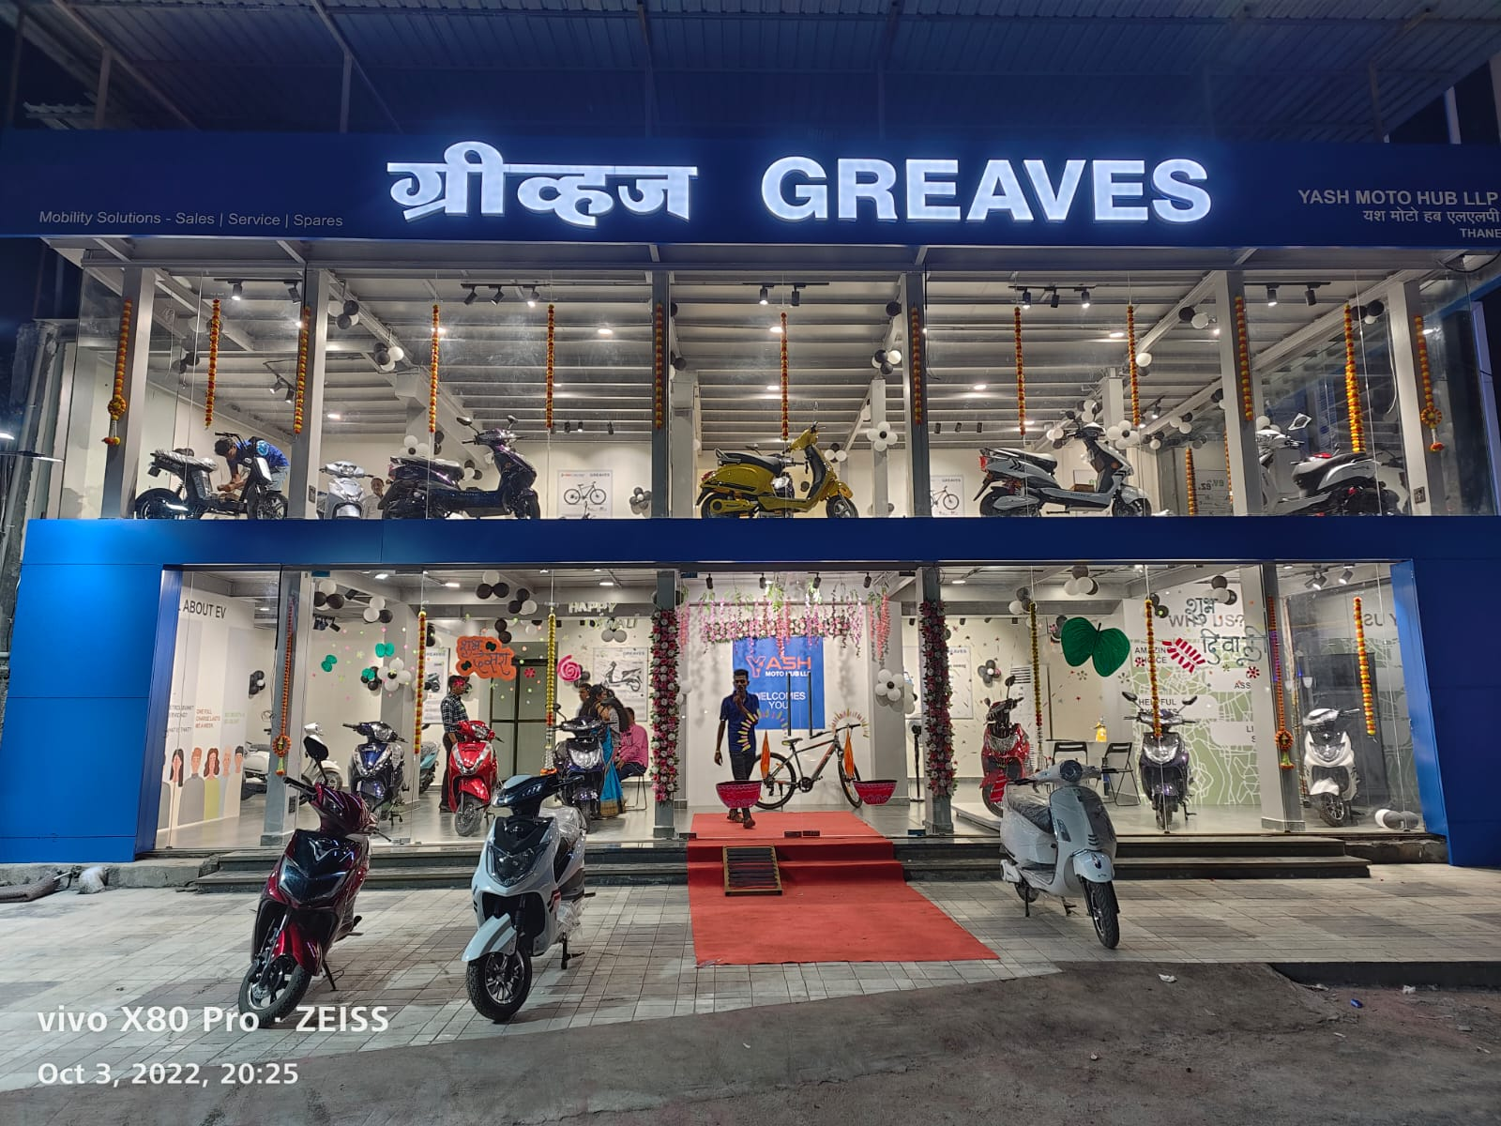
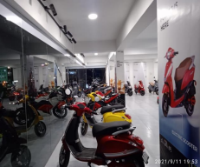
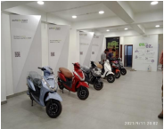
Greaves Retail Solutions – leading player in auto spares, service & retailing of electric vehicles
Quick Service
Genuine Spares
Online to Offline shopping experience
A complete phygital experience for today’s new age customer
6 Months Warranty
Quality Repairs
Multi-brand Retail network
Multiple brand options to choose from in E2W
Engine Overhaul
Value for Money
Wide variety of Electric products
E-scooters, e-cycles, and retrofitted accessories for both personal and commercial use
Pan India Presence
End-to-end Vehicle Repair and Maintenance
After Sales Service
Extensive after-sales EV care experience including, finance options, service packages & EV spares

Slide 8


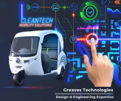

Key Business Enablers: developing expertise across ecosystem
Tech-enabled financing for electric vehicles with deep understanding of asset risk
Enabled business with 15+ banks and financial institutions
Strong EV financing network in tier-II, tier-III and tier-IV cities apart from metros with financing for both e2W & e3W
Finance penetration of e-mobility at 30% in Q2 FY23
Aspires to be a technology convergence catalyser for the company’s products, looping back cutting-edge technology and solutions from around the world
Dynamic and technology driven global engineering services & solutions company
Proven expertise and credibility in the automotive product engineering life cycle

Slide 9
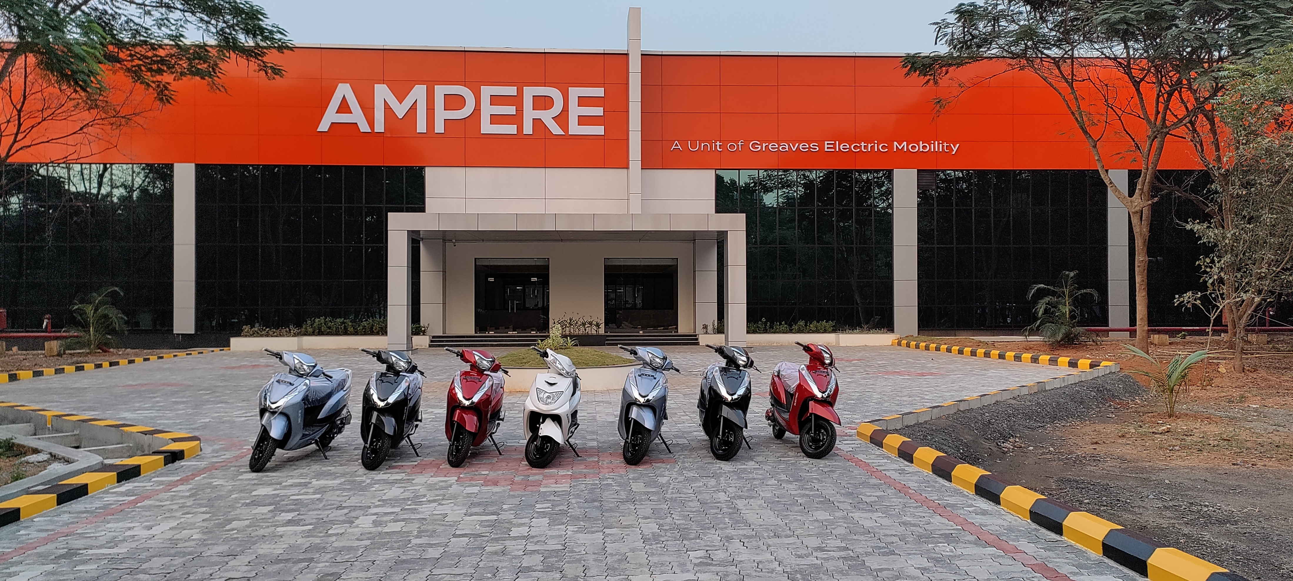





Making India a global EV destination
Rolled out more than 90k E2W from its production facility in Ranipet.
The facility was inaugurated in November 2021
The Capital Infusion from Abdul Latif Jameel Group will further boost the capex projects
With a capacity of 240,000 units p.a. Ranipet plant is well-equipped to cater to the growing demand. Capacity will be gradually ramped-up to 1 million units
Aiming at diversity and gender inclusion, Greaves is at its forefront with 70% women workforce at Ranipet
Supports flagship initiatives of the Government of India, such as ‘Make in India’ and ‘Atmanirbhar Bharat’

Slide 10
AIS 156 – GEMPL implementation plan
The new EV battery safety norms being brought into effect in two phases. Phase 1 will begin on 1 December 2022, and Phase 2 will come into effect on 31 March 2023
The Ministry of Road Transport and Highways (MoRTH) had announced safety measures in the battery safety standards to create a safe and clean mobility infrastructure in the country
The revised standards call for stricter cell-level safety checks, water ingress protection, better insulation, at least four temperature sensors for thermal monitoring, and thermal propagation tests to ensure that a thermal runaway in one cell doesn't spread to other cells in the battery. It also mandates adequate spacing of individual cells in a battery pack, fire resistance, ‘suitable’ sensors that can send out audio-visual warnings to detect and warn in advance of the onset of thermal runaway, smarter battery management systems (BMS) and chargers.
PHASE 1
Fully geared up to meet the compliance deadlines for both the phases
PHASE 2
Industry revenues may get impacted in Q3 due to the transition phase

Slide 11







Greaves Electric Mobility : new product launches
Continuous improvement in vehicle platforms components, product engineering, features & connectivity
2W
3W
Next 18-24
months
Next 18-24
months
COMING SOON
Primus
Auto Expo Launch
COMING SOON
Pre - FY23
Zeal (B2C)
New model
Auto Expo
Unveil
ePro 1.0
In Production
ePro 2.0
Auto Expo Unveil
Next Gen – L5N
Auto Expo
Unveil
Pre FY23
Zeal CA (B2B)
Auto Expo Unveil
CURRENT
Magnus EX
Pre - FY23
CURRENT
TEJA - Diesel
TEJA CNG
For both Passenger & Cargo
City speed mass market scooter offering
City speed cargo b2b solution

Slide 12
Financial performance
Greaves Consolidated Result
Q2 FY23 Segment Revenues
(INR Cr.)
Greaves Standalone Result
Q2 FY22 Segment Revenues

Slide 13
Financial snapshot
Particulars (Consolidated) | Q2 |  | Growth (%) | Q1 | Growth (%) | H1 |  | Growth (%)
(Rs. Cr.) | FY23 | FY22 | Y-o-Y | FY23 | Q-o-Q | FY23 | FY22 | Y-o-Y
Income from Operations | 699 | 374 | 87% | 660 | 6% | 1,359 | 602 | 126%
RMC (%) | 73.3% | 74.5% |  | 73.8% |  | 73.5% | 73.3%
Employee Cost | 50 | 41 |  | 46 |  | 96 | 83
Other Expenses | 94 | 64 |  | 88 |  | 183 | 105
EBITDA | 43 | (10) | NM | 38 | 12% | 81 | (27) | NM
EBITDA Margin (%) | 6.1% | (2.7%) |  | 5.8% |  | 6.0% | (4.5%)
PAT | 32 | (23) | NM | 16 | NM | 48 | (46) | NM
PAT Margin (%) | 4.6% | (6.2%) |  | 2.4% |  | 3.6% | (7.6%)
Particulars (Standalone) | Q2 |  | Growth (%) | Q1 | Growth (%) | H1 |  | Growth (%)
(Rs. Cr.) | FY23 | FY22 | Y-o-Y | FY23 | Q-o-Q | FY23 | FY22 | Y-o-Y
Income from Operations | 374 | 284 | 32% | 374 | 0.2% | 748 | 498 | 50%
RMC (%) | 71.6% | 72.0% |  | 72.9% |  | 72.2% | 71.2%
Employee Cost | 29 | 34 |  | 29 |  | 58 | 69
Other Expenses | 44 | 41 |  | 45 |  | 89 | 76
EBITDA | 33 | 4 | 644% | 27 | 21% | 61 | (2) | NM
EBITDA Margin (%) | 8.9% | 1.6% |  | 7.3% |  | 8.1% | (0.3%)
PAT | 23 | 8 | 171% | 36 | (36%) | 58 | 2 | 3016%
PAT Margin (%) | 6.1% | 2.9% |  | 9.5% |  | 7.8% | 0.4%

Slide 14
Segment volume
Volumes (Units) | Q2 |  | Growth (%) | Q1 | Growth (%) | H1 |  | Growth (%)
 | FY23 | FY22 | Y-o-Y | FY23 | Q-o-Q | FY23 | FY22 | Y-o-Y
Auto Engines | 16,207 | 8,667 | 87% | 16,112 | 1% | 32,319 | 18,093 | 79%
Non-Auto Engines | 9,563 | 11,032 | (13%) | 10,110 | (5%) | 19,673 | 20,479 | (4%)
Engines | 25,770 | 19,699 | 31% | 26,222 | (2%) | 51,992 | 38,572 | 35%
Non-Auto Applications | 3,704 | 9,845 | (62%) | 9,279 | (60%) | 12,983 | 17,286 | (25%)
E-2W | 30,873 | 10,103 | 206% | 28,787 | 7% | 59,660 | 11,486 | 419%
E-3W | 2,070 | 3,177 | (35%) | 790 | 162% | 2,860 | 3,947 | (28%)
E-Mobility Products | 32,943 | 13,280 | 148% | 29,577 | 11% | 62,520 | 15,433 | 305%

Slide 15
Balance sheet and cash flow trend
(Rs. Cr.) | Sep-21 | Mar-22 | Sep-22
Cash & Cash Equivalent | 279 | 438 | 1,336
Short Term Debt | 11 | 64 | 18
Long Term Debt | 4 | 169 | 50
Total Debt | 14 | 233 | 68
Net Cash | 265 | 205 | 1,268
Total Equity | 735 | 749 | 1,531
Working Capital
Increase in working capital due to higher subsidy receivables & revenue growth

Slide 16
In summary - driving growth momentum
Highest ever quarterly
revenues
R&D
focus
Consolidated revenue at INR 699 crores in Q2FY23, H1FY23 revenues at INR 1359 Crores, 135% of pre Covid period (i.e. H1FY20)
Introducing technology enabled and energy
efficient products, with a greater focus on the
battery safety standards
Growing retail network
Accelerating EV adoption across India with nearly 700 outlets across distribution chain
Highest quarterly volume for e-mobility
Highest ever sales of 33k units. H1 FY23 volume higher than full year of FY22
Powertrain business
Growing with improved margins
B2C business
New products
Contribution increased to 65% in line with our customer centric approach
Robust new product roadmap for electric 2 & 3 wheelers with indigenous technology
& supply chain
New business contribution
The new businesses continues to see strong growth, with 59% revenue contribution to the overall business in Q2 FY23
Clean energy
As part of its commitment towards clean energy and affordable eclectic mobility, Ampere rolled out more than 90K E2W from its Ranipet plant

Slide 17




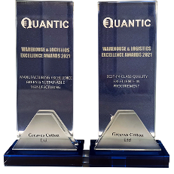

Awards and recognition
Great Place to Work-
Second year in a row
Automotive Hall of Fame Nov 2021 by ET Polymers
Manufacturing and Quality Excellence 2021 by Quantic
Promising Brands 2021 by ET
Social Impact Award 2021 by ACEF Asian Leaders

Slide 18
Disclaimer
This presentation contains statements that contain “forward looking statements” including, but without limitation, statements relating to the implementation of strategic initiatives, and other statements relating to Greaves Cotton (“Greaves” or the Company) future business developments and economic performance.
While these forward looking statements indicate our assessment and future expectations concerning the development of our business, a number of risks, uncertainties and other unknown factors could cause actual developments and results to differ materially from our expectations.
The product photographs in the presentation are only indicative, and actual products may vary from the same.
These factors include, but are not limited to, general market, macro-economic, governmental and regulatory trends, movements in currency exchange and interest rates, competitive pressures, technological developments, changes in the financial conditions of third parties dealing with us, legislative developments, and other key factors that could affect our business and financial performance.
Greaves undertakes no obligation to publicly revise any forward looking statements to reflect future / likely events or circumstances.

Slide 19





SOUND FUNDAMENTALS| STABLE CASHFLOW | AGILE STRUCTURE
GROWING BRANDS | GROWING RETAIL FOOTPRINT | GROWING CUSTOMER BASE
MOBILITY SOLUTIONS | MOVING PEOPLE | MOVING CARGO
THANK YOU
For further information, please contact
Jaylaxmi Kumar Sr. General Manager - Marketing & Corporate Communications Greaves Cotton | Anvita Raghuram / Bhushan Khandelwal Churchgate Partners
+91 22 4171 1700 investorservices@greavescotton.com | +91 22 6169 5988 greavescotton@churchgatepartners.com

